Slide 1
Final Project Presentation
Analysis of OASDI and SSI Data (Spending and Beneficiaries)
By Tejas Jagadeesh
HCDE DATA 512, Fall 2018

Slide 2
Introduction
OASDI stands for Old-Age, Survivors, Disability Insurance. It is part of Social Security Disability program. It is provided as support to people who are retired and families (dependent spouses and children) of workers who have died. Additional details on its history can be found here on Wikipedia - https://en.wikipedia.org/wiki/Social_Security_(United_States)
SSI stands for Supplemental Security Income. It is part of Social Security and involves monthly payment as support to people with limited income and people who are disabled, blind or aged 65 years and above. Additional details about SSI can be found here - https://www.ssa.gov/ssi/text-over-ussi.htm
Both programs are administered by Social Security Administration (SSA) - https://www.ssa.gov/

Slide 3
Data
Each year congressional reports are published with information of SSI and OASDI payments made by each state. This report includes information about no. of recipients in each category and the total payments made for each state. Reports for years 2013, 2014, 2015, 2016 and 2017 has been used for analysis
OASDI Categories – Retired Workers and Families
SSI Categories – Aged, Blind and Disabled
Population data for US for the years 2013, 2014, 2015, 2016 and 2017.

Slide 4
Motivation
Understand the distribution of people benefiting from OASDI and SSI across US.
Identify any trends in spending (if present).

Slide 5
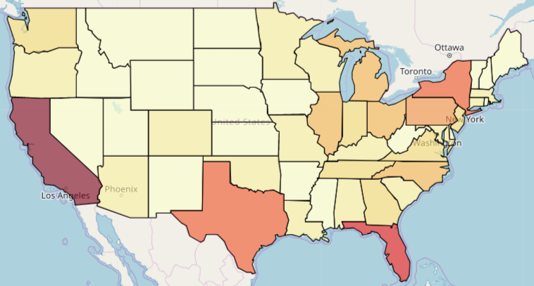
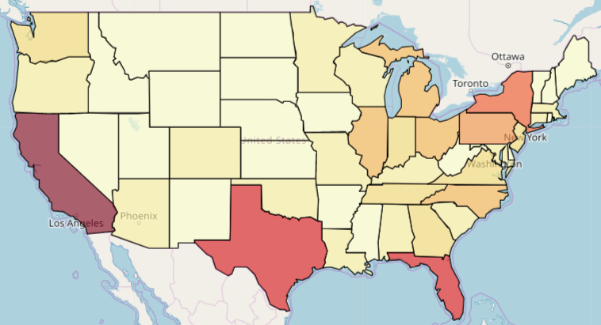
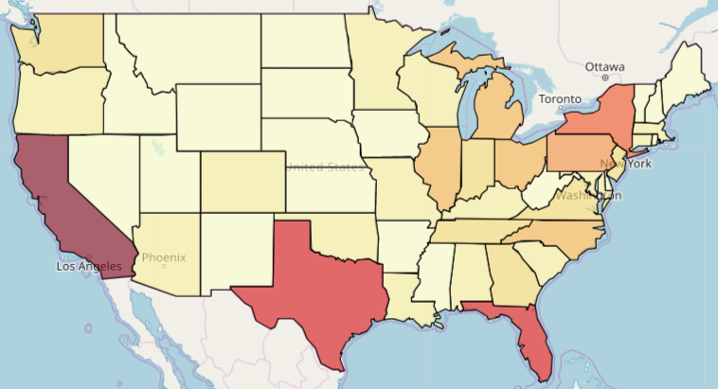
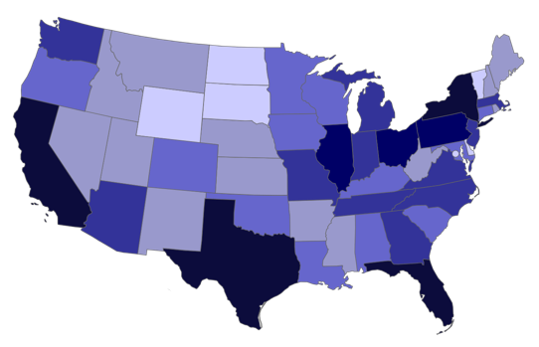
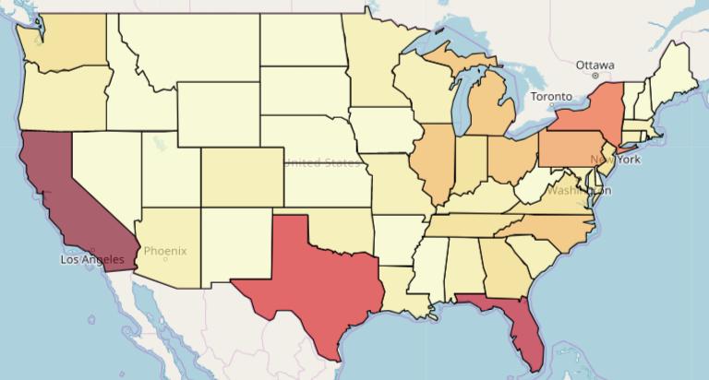
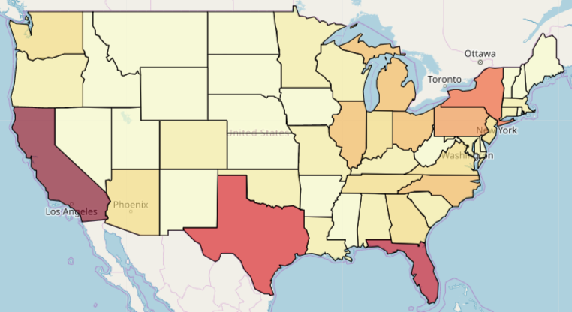
Results – Distribution of Total Spending - OASDI
(1) No Major Trend (2) Aligns with Population
2013
2014
2015
2016
2017
US Population
Source: Wikipedia
Low
High
L
H

Slide 6
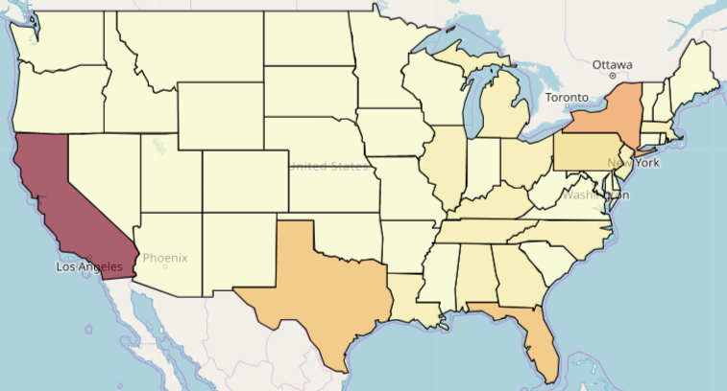
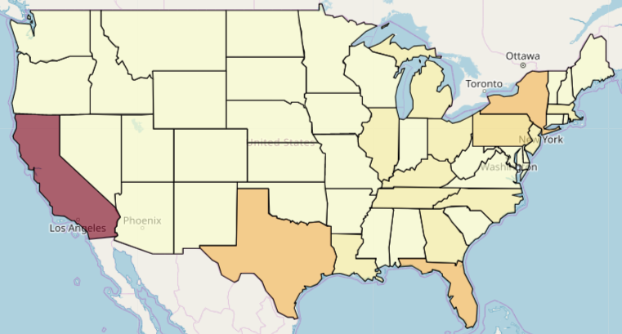
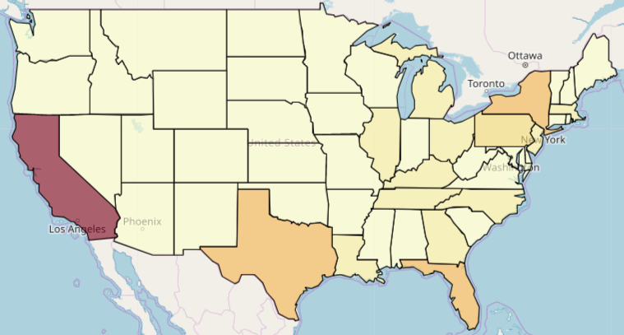


Results – Distribution of Total Spending - SSI
(1) No Major Trend (2) Aligns with Population (3) CA the only High Spender
2013
2014
2015
2016
2017
US Population
Source: Wikipedia
Low
High
L
H

Slide 7
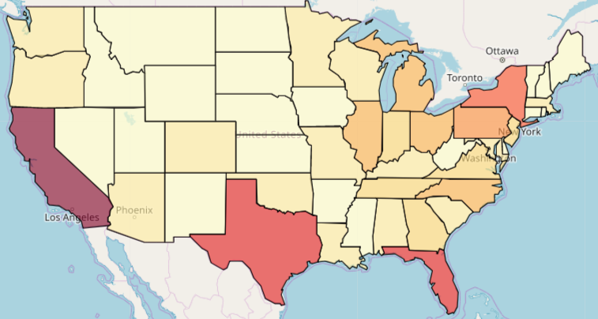


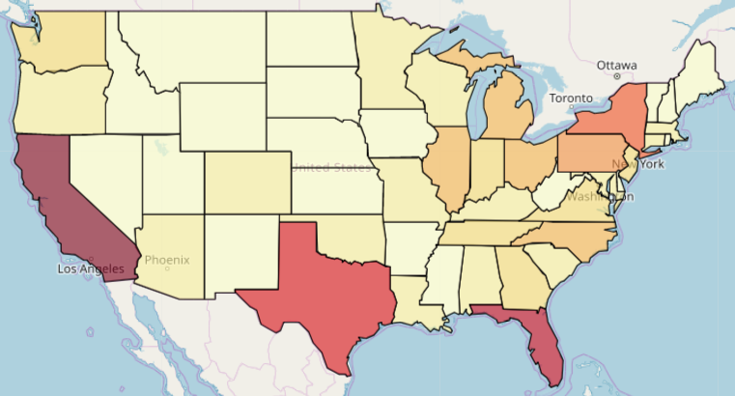
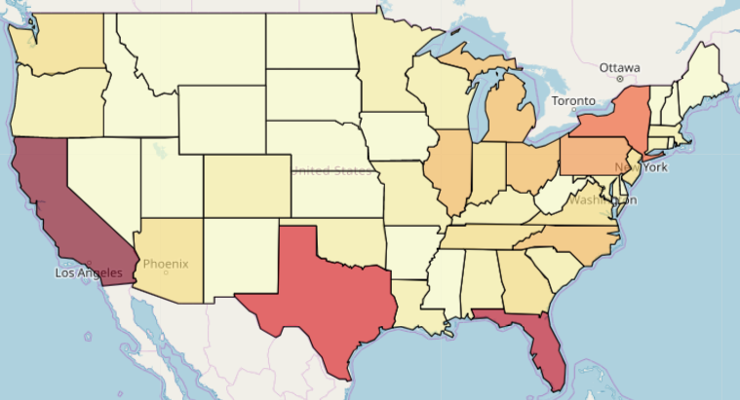
Results – Distribution of Total Beneficiaries - OASDI
(1) No Major Trend (2) Aligns with Population
2013
2014
2015
2016
2017
US Population
Source: Wikipedia
Low
High
L
H

Slide 8
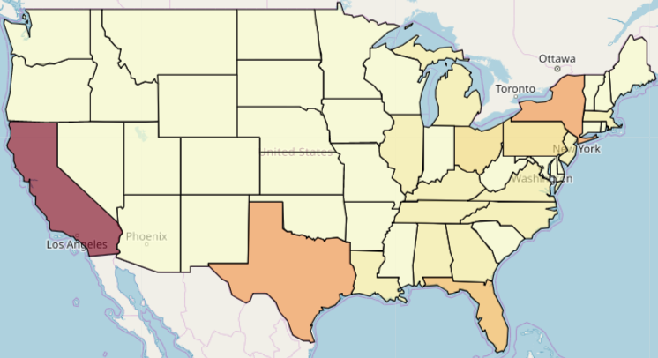
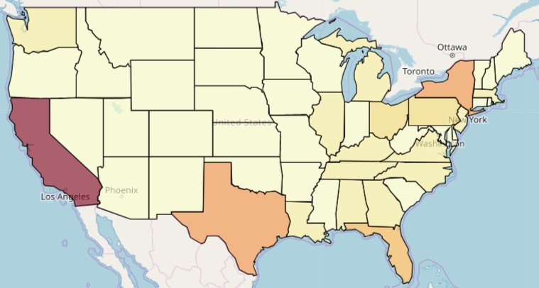
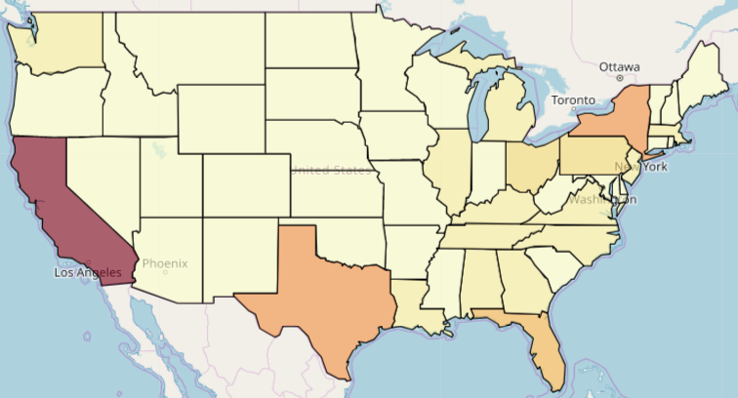
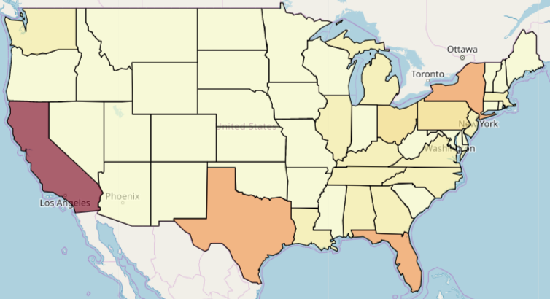
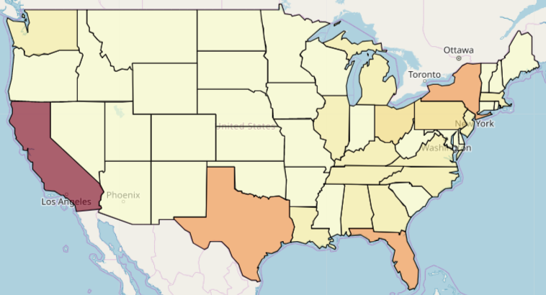
Results – Distribution of Total Beneficiaries - SSI
(1) No Major Trend (2) Aligns with Population (3) CA the only High Spender
2013
2014
2015
2016
2017
US Population
Source: Wikipedia
Low
High
L
H

Slide 9
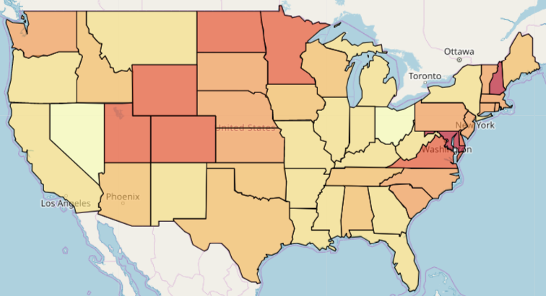
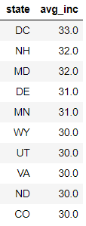
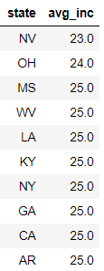
Results – Avg Increase in Spending per Person - OASDI
(1) Top Spenders don’t feature in Top 10 (2) Doesn’t align with population
Top 10
Bottom 10
23 USD
33 USD
Figures are in USD

Slide 10
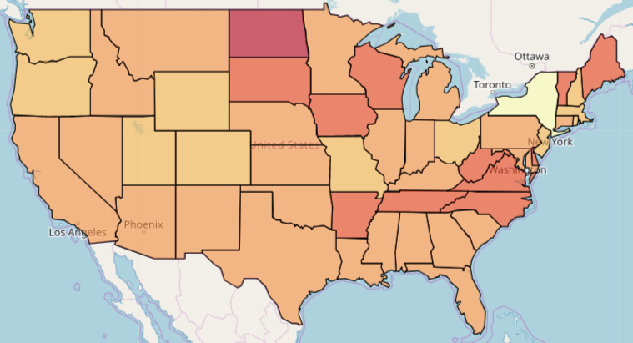
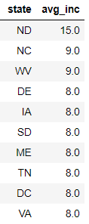
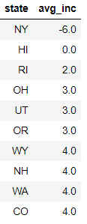
Results – Avg Increase in Spending per Person - SSI
(1) Almost even across states (2) Doesn’t align with population (3) NY the only state with decrease
Top 10
Bottom 10
-6 USD
15 USD
Figures are in USD

Slide 11
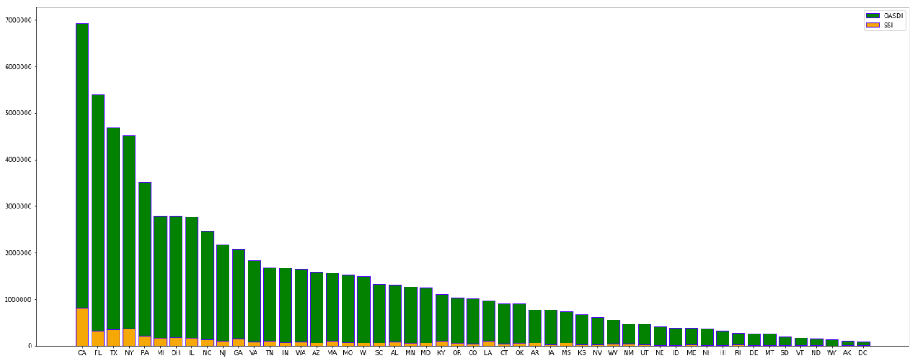
Results – OASDI vs. SSI spending
(1) SSI is a small fraction of OASDI spending
Arranged in decreasing order of OASDI spending
USD
State Codes

Slide 12
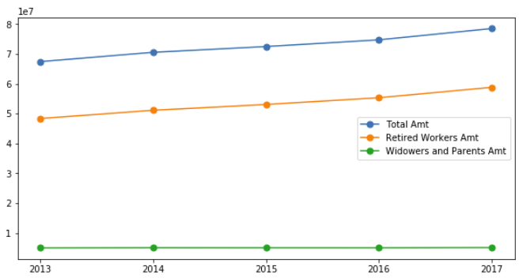
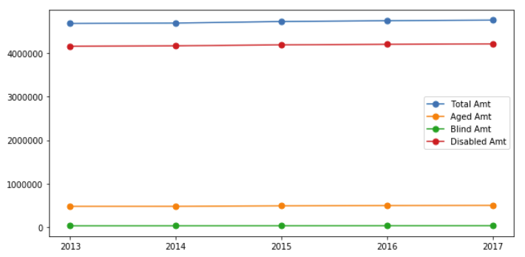
Results – Category-Wise spending trend across years
OASDI
SSI
USD
(10 mil)
USD
(1) Retired Workers get the lion’s share
(1) Disabled category gets the lion’s share

Slide 13
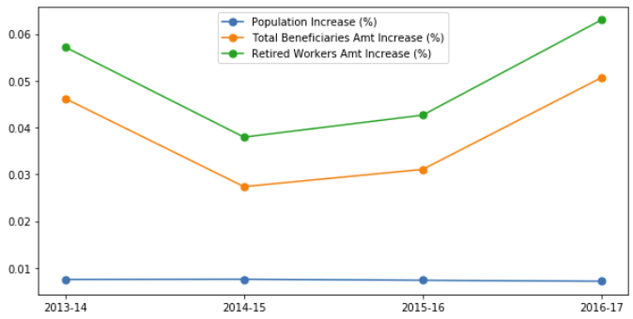
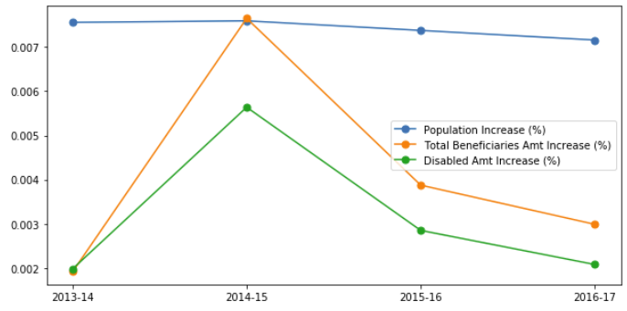
Results – Spending increase vs. Population increase
% Increase in both
OASDI
SSI
%
increase
%
increase
(1) OASDI increasing (2) More Retired Workers?
(1) SSI decreasing (2) Fewer Disabled People?

Slide 14
Conclusion
SSI spending is small fraction of OASDI spending.
At high level, the spending and beneficiaries per state appear to correlate positively with state’s population.
The analysis raises more questions which needs further analysis based on additional data.

